Slide 1
Front End Engineering-I Project
Team Details:
1. Mridul Chauhan : 2410993161
2. Mukul Poonia : 2410993163
3. Adarsh Arya : 2410993097
:
Chitkara University Institute of Engineering and Technology,
Chitkara University, Punjab

Slide 2
Table of Contents
•Introduction
•Problem Statement
•Technical Highlights
•Key Features
•Project Advantage
•Bonus Feature(optional)
•Conclusion
•References/Links used

Slide 3
Introduction
1.1 The rapid evolution of technology has revolutionized numerous industries, including the professional landscape. Establishing an online presence has become a vital aspect for individuals seeking to showcase their expertise and accomplishments effectively.
1.2 The Build Your Own Portfolio Site project is designed to cater specifically to individuals looking to present their unique skills and achievements in a personalized and professional manner. This platform offers customizable features to highlight diverse projects, foster user engagement, and elevate the overall impact of an individual’s portfolio.

Slide 4
Problem Statement
2.1 Individuals seeking to establish a professional online presence face several challenges, including:
1.Lack of Customization: Pre-built portfolio templates often fail to reflect an individual’s unique personality, skills, or achievements effectively.
2.Limited Accessibility: Many portfolio platforms are not optimized for mobile or responsive design, limiting their reach and usability.
3.Complex Development Process: Building a portfolio from scratch can be intimidating for beginners due to the technical skills required.
4.Ineffective Presentation: Poorly designed portfolios may fail to engage viewers or effectively communicate the individual’s expertise and achievements.
2.2 To address these challenges, the Build Your Own Portfolio Site project focuses on delivering:
1. Personalization Options: Tools to customize layouts, colors, and content, ensuring the portfolio reflects the user’s unique style and skills.
2. Responsive Design: A mobile-friendly and accessible interface to ensure seamless viewing across devices.
3. Ease of Use: Simplified development processes with intuitive features for beginners to create their portfolio without advanced coding knowledge.
4. Enhanced Presentation: Professional templates and interactive elements to engage viewers and effectively highlight the individual’s expertise and achievements.

Slide 5
Technical Highlights
3.1 Technical Foundation: The Build Your Own Portfolio Site is developed using modern web technologies, ensuring a robust, responsive, and visually appealing platform:
3.1.1 HTML (Hyper Text Markup Language): HTML forms the structural backbone of the portfolio site, defining elements like headers, sections, images, and links. It enables the creation of an organized and accessible layout.
3.1.2 CSS (Cascading Style Sheets): CSS is utilized to enhance the aesthetics and overall design of the portfolio. Key features include: • Responsive Layout: Media queries are implemented to ensure the site looks and functions seamlessly across all devices and screen sizes. • Consistent Styling: A unified color scheme, typography, and spacing are maintained throughout to ensure visual harmony.
3.1.3 JavaScript (JS): JavaScript introduces dynamic features and interactivity to the portfolio site. It facilitates animations, interactive forms, and other elements that improve user engagement and functionality.
3.1.4 Bootstrap: Bootstrap simplifies the development process by providing a responsive grid system and pre-designed components, such as navigation bars and buttons. This ensures a professional look while speeding up development.

Slide 6
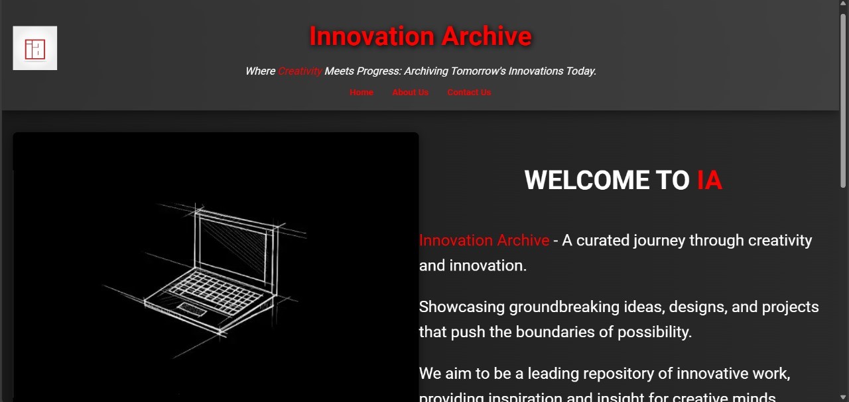
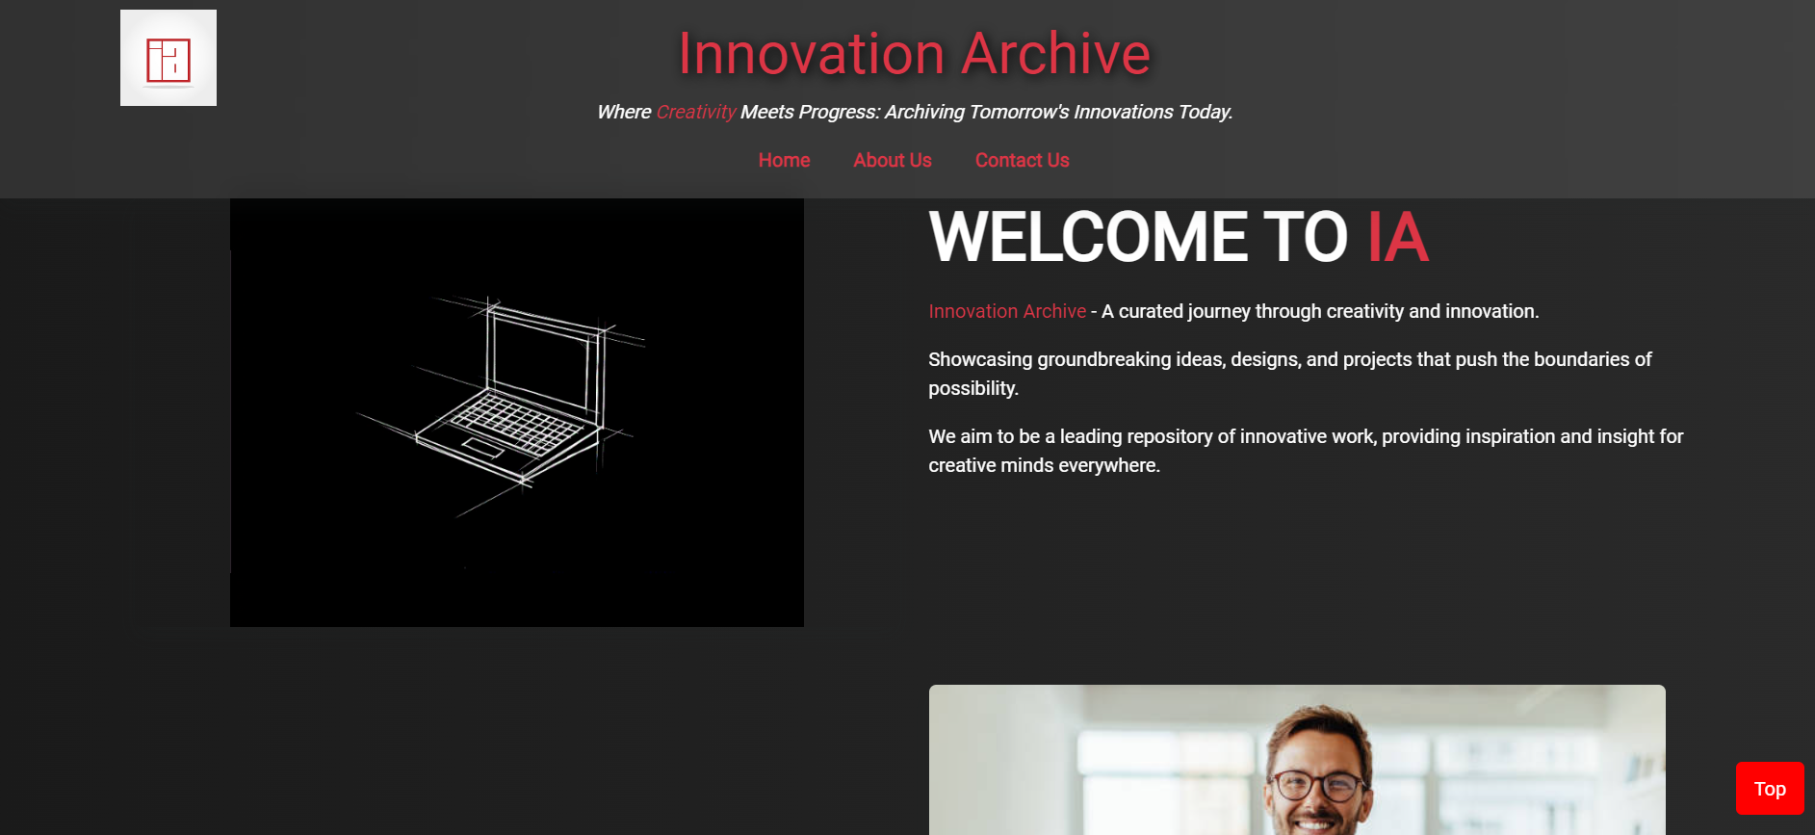
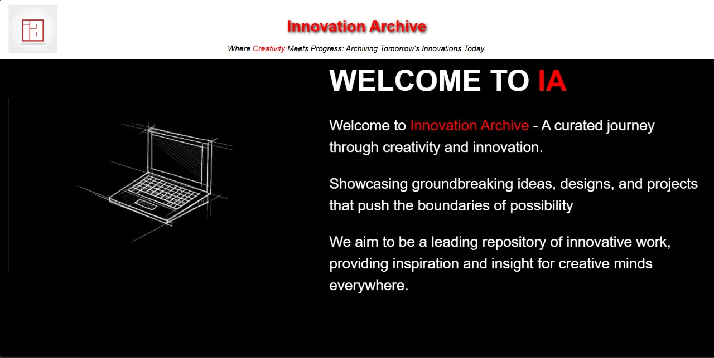
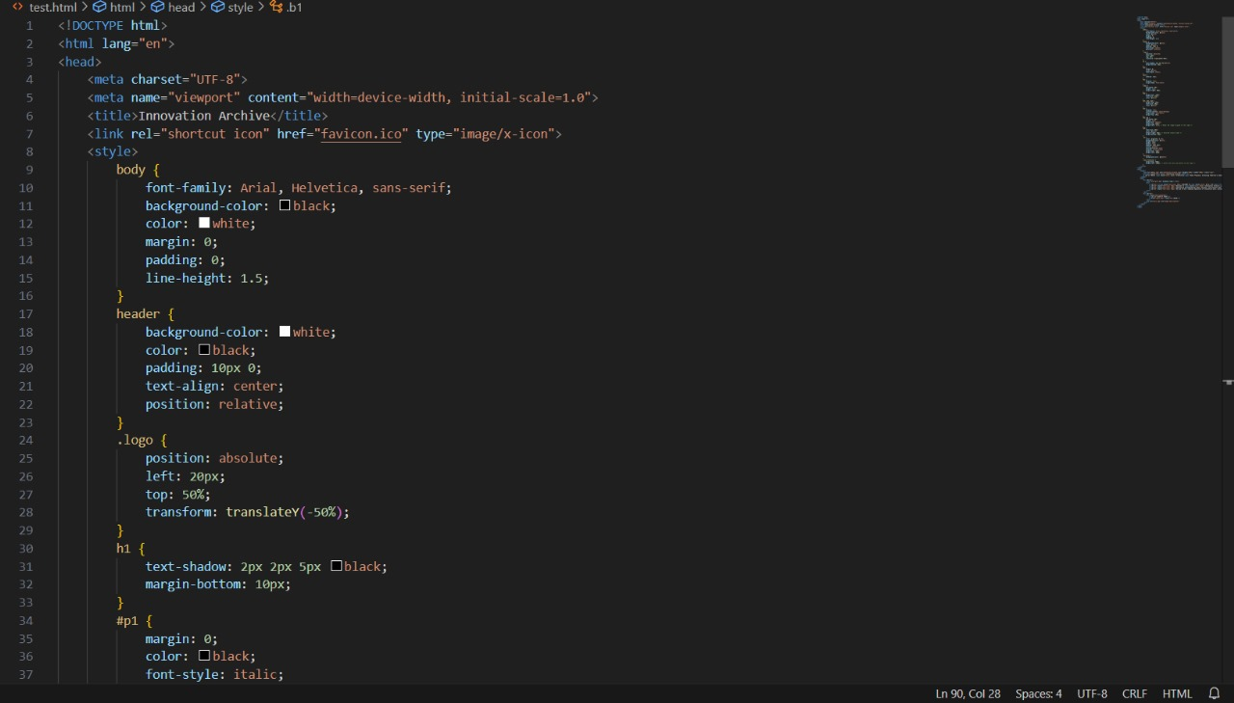
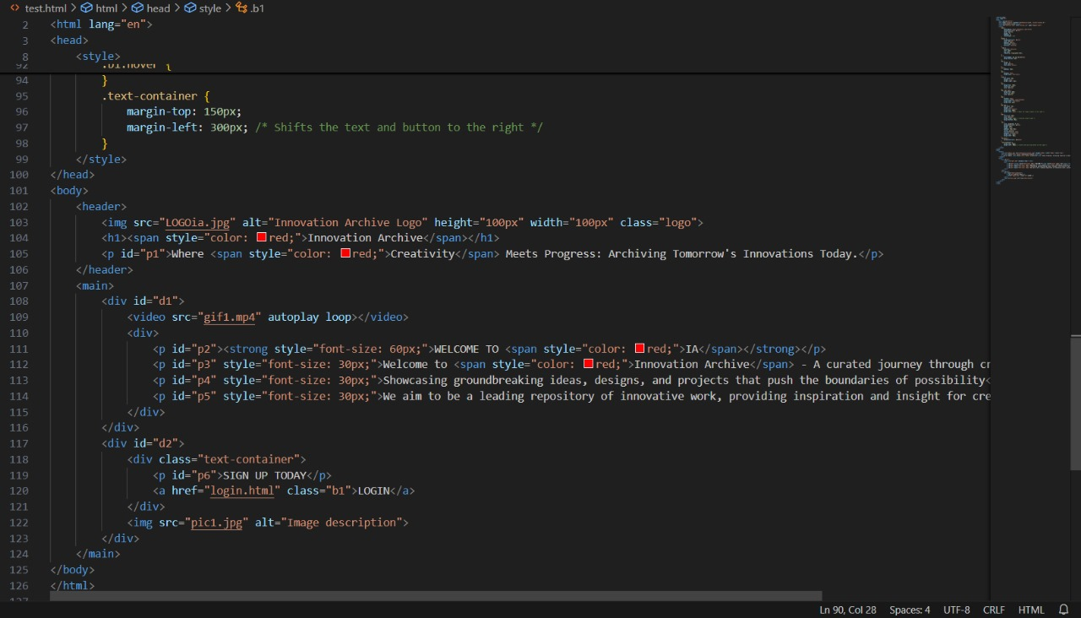
Project Highlights

Slide 7
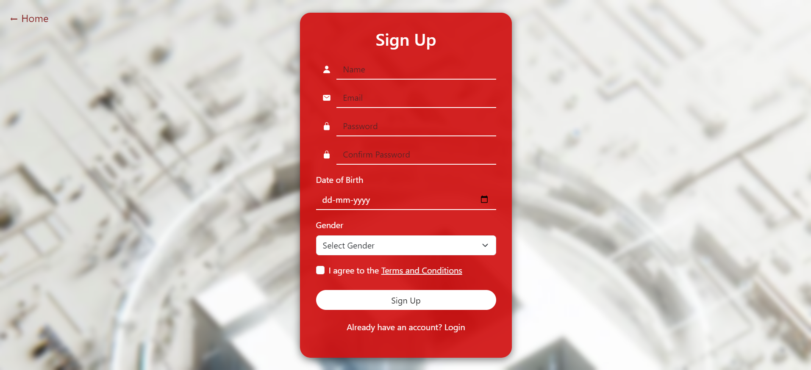
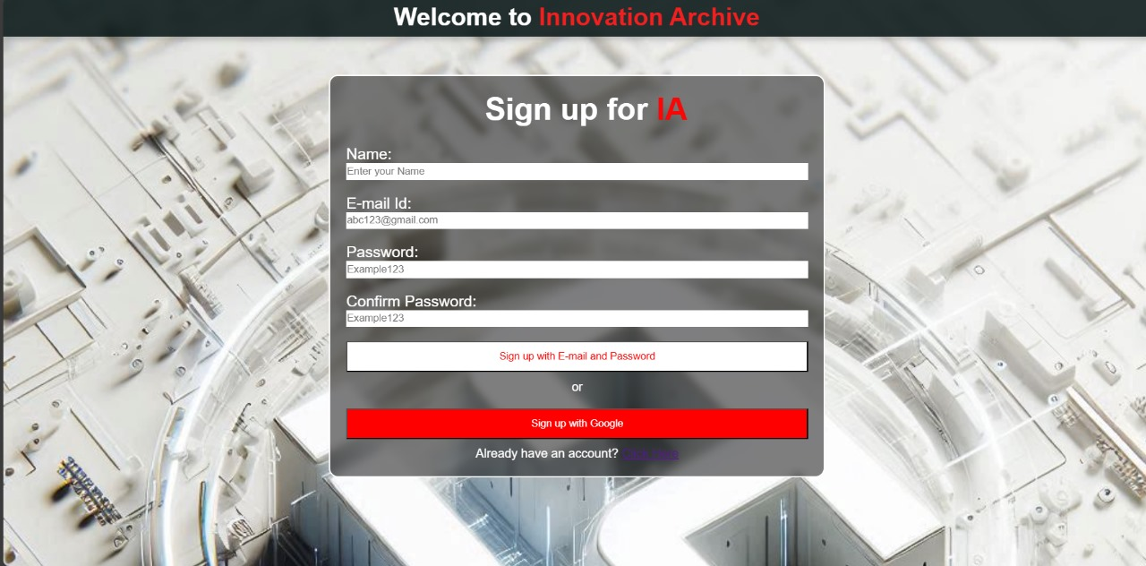
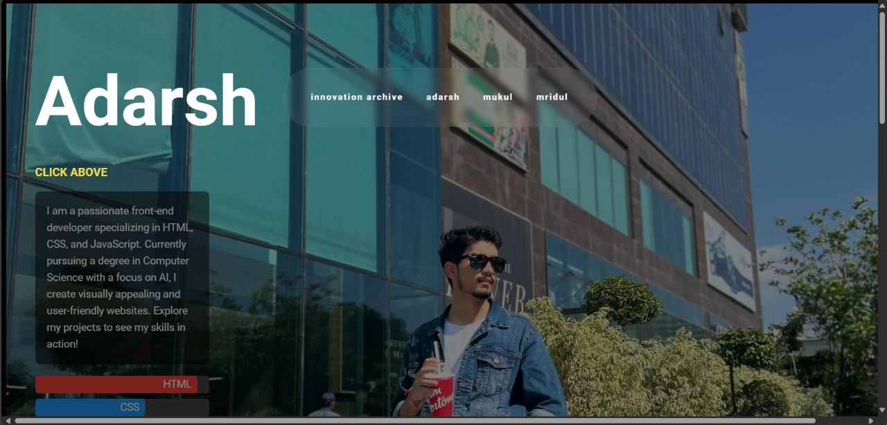
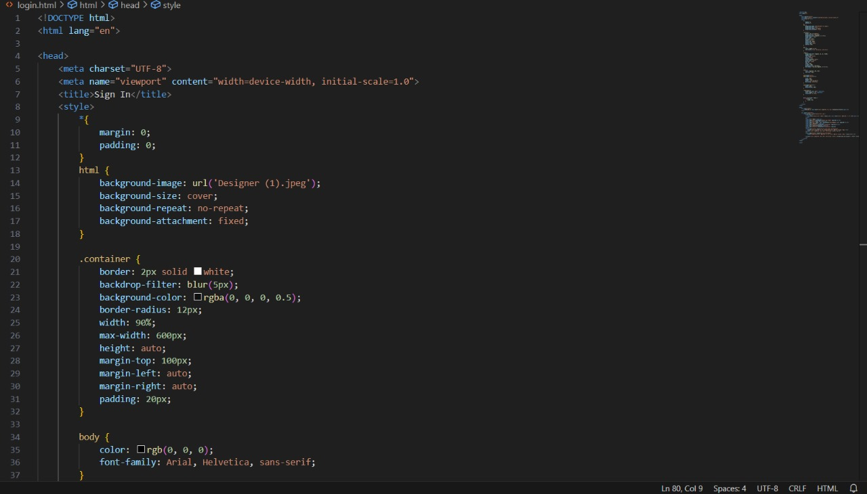
Project Highlights

Slide 8
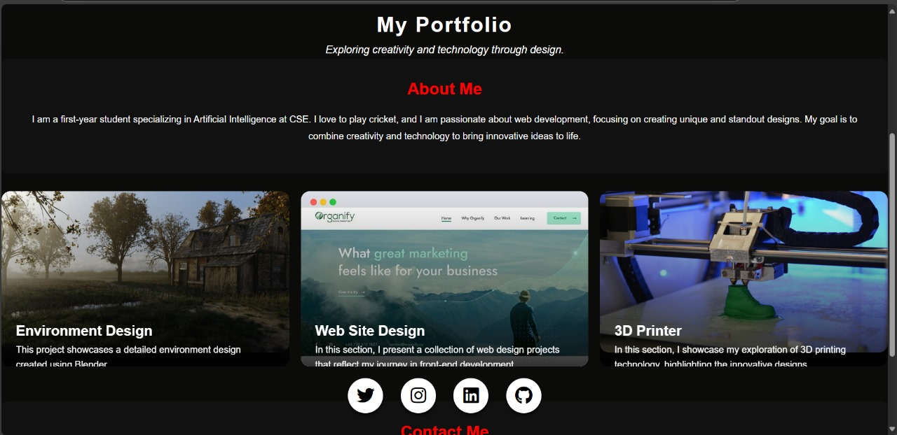
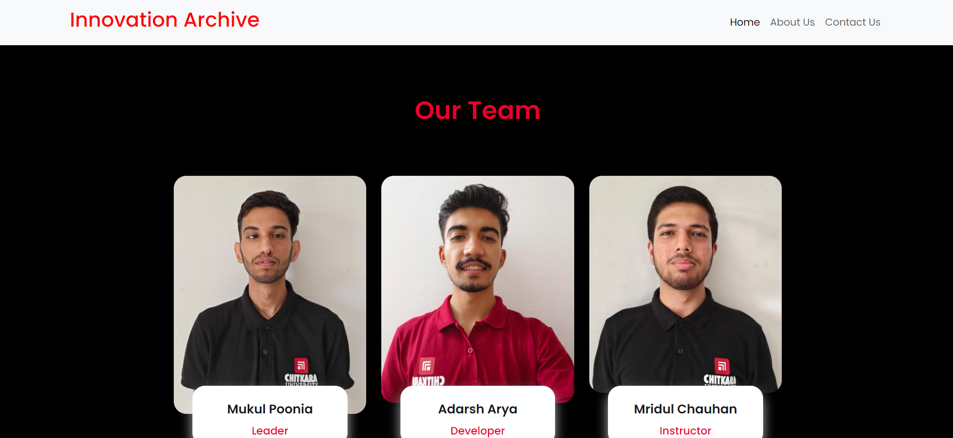
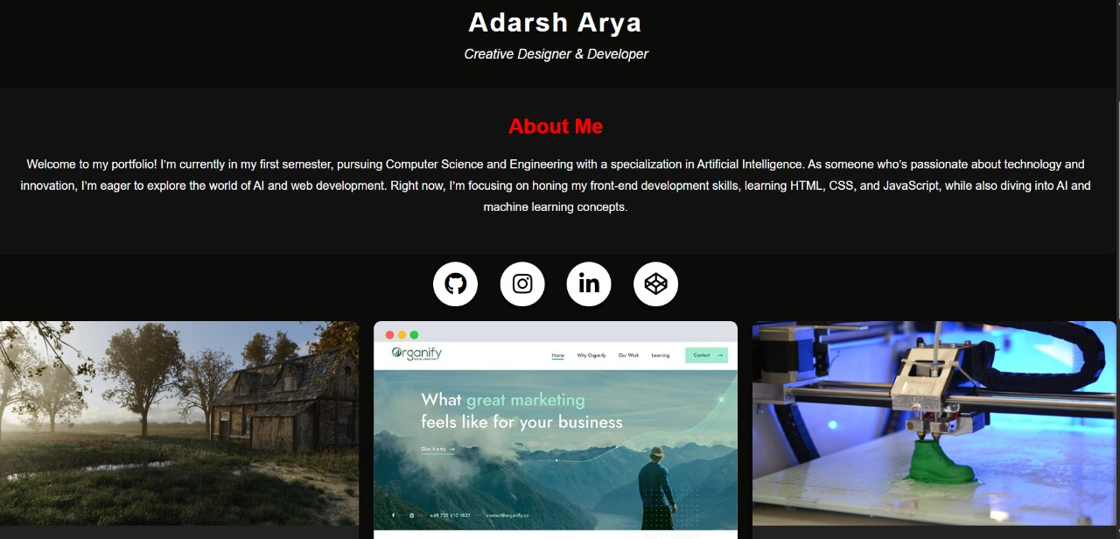
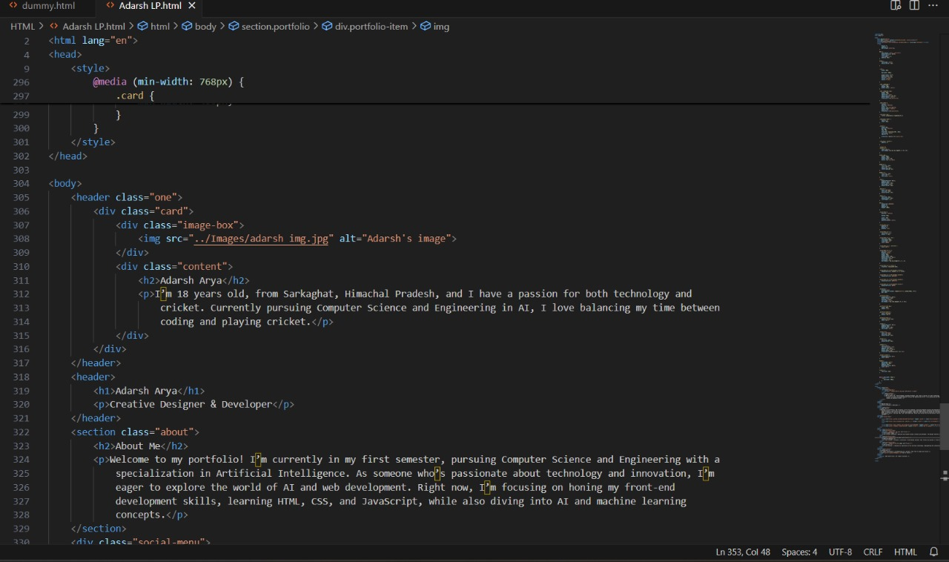
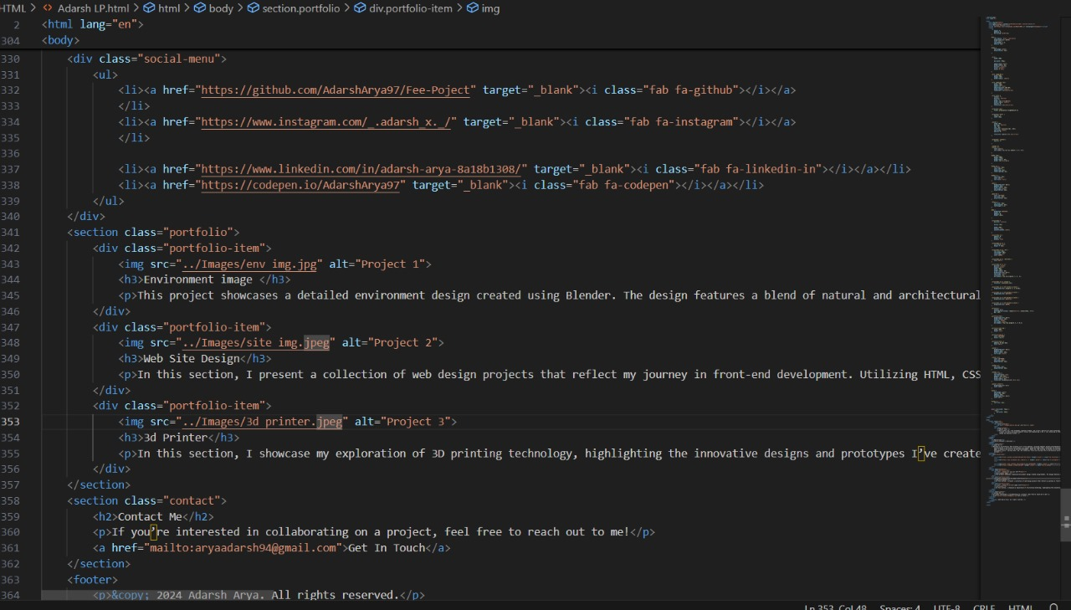
Project Highlights

Slide 9
Key Features
4.1 Project Showcase: A visually appealing section to highlight completed projects, including detailed descriptions, images, and links to live demos or repositories.
4.2 About Me: A personalized section to introduce the portfolio owner, showcasing their background, skills, and interests. This section may also include a downloadable resume or links to professional profiles.
4.3 Skills Section: A dedicated area to display technical and soft skills, often represented with icons, progress bars, or other creative visual elements.
4.4 Responsive Design: The site is optimized for various screen sizes, ensuring seamless navigation and usability on desktops, tablets, and mobile devices.
4.5 Contact Section: An easy-to-access section where users can connect via email, social media handles, or a built-in contact form.
4.6 Interactive Navigation: Intuitive menus and smooth scrolling ensure effortless movement between sections, enhancing the user experience.
4.7 Image and Media Gallery: A gallery to showcase visuals such as project screenshots, design concepts, or other media that reflects the portfolio owner’s work and creativity.

Slide 10
Project Advantages:
5.1 The Build Your Own Portfolio Site offers several advantages:
Enhanced Professional Presence: The platform serves as a professional and visually appealing representation, helping individuals stand out in competitive fields.
Customization and Personalization: Users can create a unique site that reflects their personality, skills, and achievements, making a strong impression on potential clients or employers.
Accessibility Across Devices: With a responsive design, the portfolio is compatible with desktops, tablets, and mobile devices, ensuring it reaches a wider audience.
Showcase of Skills and Projects: The site allows users to effectively display their work, expertise, and accomplishments, offering a comprehensive overview to visitors.
Ease of Use for Beginners: Simplified development processes and tools ensure that even individuals with limited technical knowledge can create a professional portfolio.
Improved Networking Opportunities: By integrating contact forms and links to social media or professional profiles, the portfolio facilitates easy connections with recruiters, clients, or collaborators.
Boosted Credibility and Visibility: A well-crafted portfolio builds trust and showcases expertise, helping users establish themselves as professionals in their domain.

Slide 11
Bonus Features:
6.1 Bonus Features and Future Enhancements:
The Build Your Own Portfolio Site can be expanded with the following features to enhance functionality and user experience:
Interactive Dashboard: A personalized dashboard for the portfolio owner to manage and update content easily without needing to modify code directly.
User Authentication: Login and sign-up functionality using JavaScript to allow recruiters or clients to create accounts and leave feedback or track updates related to projects.
Dark/Light Mode Toggle: An aesthetic feature that enables visitors to switch between dark and light themes for better usability and personal preference.
Analytics Integration: Adding tools like Google Analytics to track visitor statistics, page views, and user interactions, helping the owner optimize their portfolio’s effectiveness.
Project Filtering and Sorting: A dynamic feature to filter and sort projects based on categories or technologies, improving accessibility for viewers.
AI Chat Assistant: Implementing an AI-driven assistant to answer visitor queries, guide them through the portfolio, or provide quick links to specific sections.

Slide 12
Conclusion
9.1 Conclusion: In conclusion, the Build Your Own Por olio Site effectively empowers individuals to create a personalized, professional online presence. The project demonstrates how modern web technologies can enhance the user experience while simplifying the process of building a portfolio. Future developments will focus on adding advanced features like user authentication, analycis integra on, and expanding the site’s customization opens to offer even more flexibility and functionality.
9.2 Future Enhancements: 1. User Authentication: Implement a secure login system allowing users to personalise their portfolios and track updates. 2. Advanced Customisation: Add more themes and layouts, enabling users to further personalise their portfolios.
9.3 Planned Updates:
1. Project Sor ng and Filtering: Add functionality to sort and filter projects based on categories, technology, or project type, making the site even more interactive and user-friendly.
2. Mobile App Version: Develop a mobile application for be er accessibility, allowing users to manage their portfolio on-the-go.

Slide 13
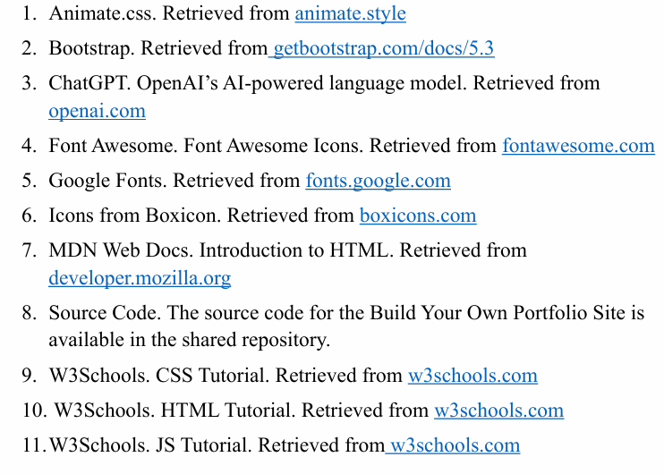
Reference/ Links Used

Slide 14


